Slide 1
BSCS-7th Semester
M. Arham
Lecturer
The University of Faisalabad

Slide 2
Compiler Construction
Course Code: CS-411
Lecture 04

Slide 3




www.tuf.edu.pk
unioffaisalabad
Credit Hours: 3(3-0)
Theory: Cr. Hr. 03
Practical: Cr. Hr. 00

Slide 4
Content
Lexical analyzer
Lexeme generation
Token
Lexeme
Pattern

Slide 5
Lexical analyzer
Reads the source program as a file of characters and divide them up into tokens.
Tokens are recognized using Finite Automata or Transition Diagram.

Slide 6
How Lexical Analyzer functions
The vital functions of lexical analyzer are:
  Separate tokens from program
  Insert tokens into symbol table
  Eliminate whitespaces, comments, newline characters, etc... from string
  Give tokens to parser (Pass their integer no./code to parser)
  Keep track of line numbers (for error handling)
  Pre-processing of macros
It reads characters from the input, groups them in lexeme and
Then passes the tokens formed by the lexemes, together with their attribute values to the parser.
In some situations, it has to read some characters ahead before it can decide on the tokens to be returned to the parser.

Slide 7
Token, Lexeme, Pattern
Token: Token is a sequence of characters that can be treated as a single logical entity. Typical tokens are,
  Identifiers
  Keywords
  Operators
  Special symbols
  Constants
  Literal strings
  Punctuation symbols (such as commas, Semi-colons)

Slide 8
Token, Lexeme, Pattern
Lexeme: A lexeme is a sequence of characters in the source program that is matched by the pattern for a token and is identified by the lexical analyzer as an instance of that token.
Ex. Relational Operator {<,>,<=,>=,==}

Slide 9
Token, Lexeme, Pattern
Pattern: Rule of description is patterns.
Gives a precise description /specification of tokens.
Used to automatically generate a lexical analyzer.
It gives a an informal or formal description of a token.
  Example: letter(letter/digit), identifier

Slide 10
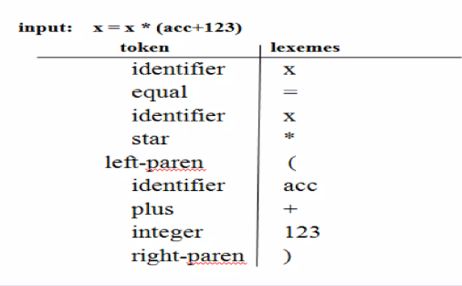
Token, Lexeme, Pattern

Slide 12
Attributes for tokens
E = M * C ** 2
  <id, pointer to symbol table entry for E>
  <assign-op>
  <id, pointer to symbol table entry for M>
  <mult-op>
  <id, pointer to symbol table entry for C>
  <exp-op>
  <number, integer value 2>
Notes:
The lexical analyzer produces tokens with attributes like this:
1. <id, pointer to symbol table entry for E>
id = token type (identifier).
Attribute = pointer to symbol table entry where details of E are stored (like data type, memory location, scope).
2. <assign-op>
assign-op = token type (assignment operator =).
No extra attribute is needed (since = always means assignment).
3. <id, pointer to symbol table entry for M>
Again, an identifier M.
Attribute = pointer to M’s record in the symbol table.
4. <mult-op>
Token type for multiplication operator *.
No attributes needed, because multiplication is unique.
5. <id, pointer to symbol table entry for C>
Identifier C.
Attribute = pointer to C’s symbol table entry.
6. <exp-op>
Token type for exponentiation operator **. (The exponentiation ( ** ) operator returns the result of raising the first operand to the power of the second operand)
No attribute, operator meaning is fixed.
7. <number, integer value 2>
Token type = number literal.
Attribute = actual value (here 2).
Why attributes?
Identifiers (E, M, C) → need pointers to symbol table, since compiler must know their type, scope, and where to store/load them.
Operators (=, *, **) → usually don’t need attributes; their role is clear.
Numbers/literals (2) → need actual values as attributes.

Slide 13
Cont….
Suppose we pass a statement through lexical analyzer –
a = b + c ;
It will generate token sequence like this:
id=id+id;
Where each id reference to it’s variable in the symbol table referencing all details

Slide 14
Reference
https://www.slideshare.net/slideshow/lecture-1-lexical-analysisppt/256050022
https://www.slideshare.net/slideshow/lexical-analysis-compiler-design-249767853/249767853

Slide 15
www.tuf.edu.pk
unioffaisalabad
Advice…!!
Kindly read the book before and after the lecture, if some terms/ words are not covered in the lecture, if appear in exam it might not appear strange or out of course.

